Slide 1

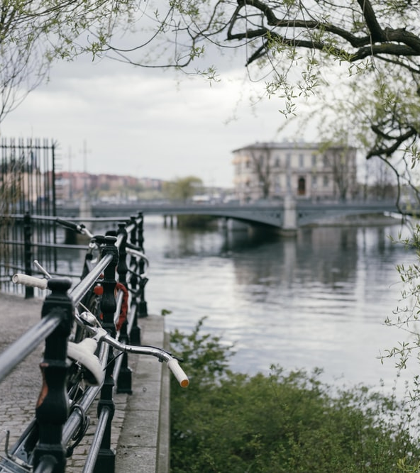

Live Class
Via Zoom
Chapter VII.
The Spectacular
Now

Slide 2



Index / Índice. “The Spectacular Now”
1
Introduction and Objective
6
What are they doing?
2
Celebrations around the World
7
Sports and Activties
3
Describe the Seasons
8
Mime Time
4
Select the Correct Word
9
My Weekend
5
Present Continuous
10
What have I learnt today? …
Book II: Linda in Real Life
Centro de Idiomas 2019

Slide 3
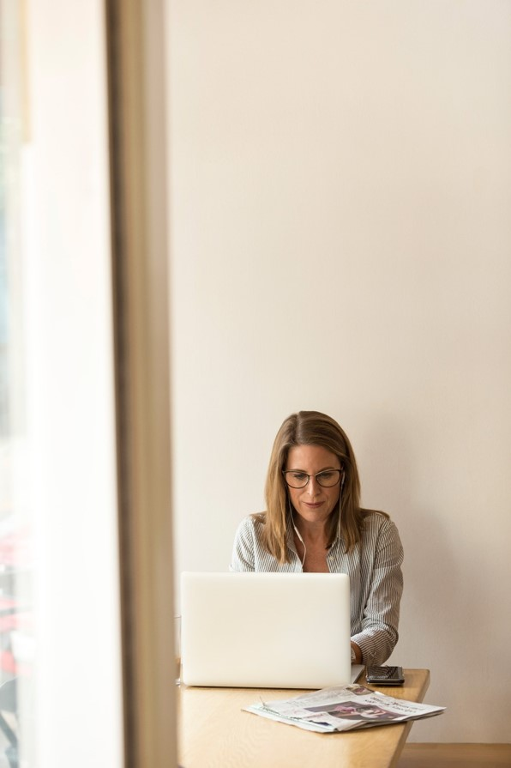
Part I. Introduction
Welcome to this live videoconference class!
In this final part of the chapter, you’ll put into practice everything you’ve learnt in the previous steps through dialogues, monologues, group discussion, games and other fun exercises.
The class is an important moment through which you can interact with your teacher and classmates in the contextualized situations from your virtual journey to learn English aboard.
Good luck!
¡Bienvenido / Bienvenida a esta clase por videoconferencia en vivo!
En esta parte final del capítulo, pondrás en práctica todo lo que has aprendido en los pasos previos a través de diálogos, monólogos, grupos de discusión, juegos y otros ejercicios divertidos.
La clase es un momento importante a través del cual puedes interactuar con tu maestro y compañeros en las situaciones contextualizadas de tu viaje virtual para aprender inglés en el extranjero.
¡Buena suerte!
Book II: Linda in Real Life
Centro de Idiomas 2019

Slide 4
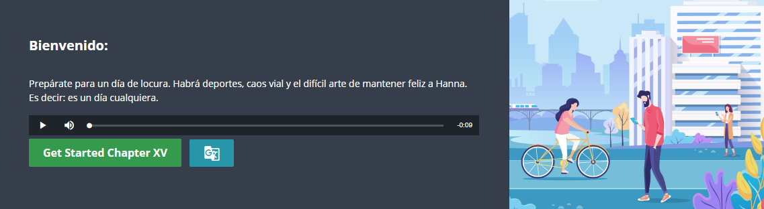
Part I. Class Objective
By the end of the class, you will be able to discuss the topic of the weather and describe seasons of year. You’ll also be able to talk about sports and outdoor activities, as well as use the present continuous tense to describe actions at the time of speaking.
Al final de la clase, serás capaz de hablar del tema del clima y describir las estaciones del año. Además, podrás hablar de deportes y actividades al aire libre, así como usar el tiempo presente continuo para describir acciones al momento de hablar.
Book II: Linda in Real Life
Centro de Idiomas 2019

Slide 5
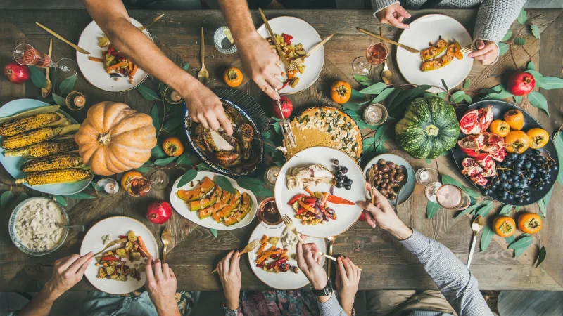
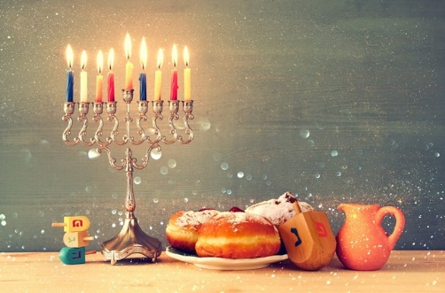
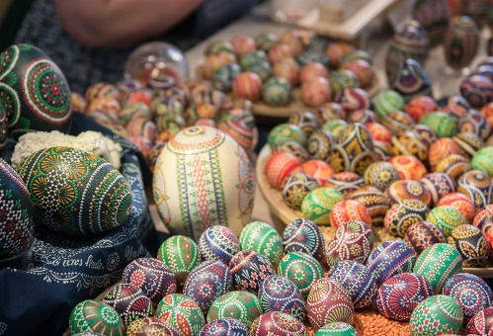
Part II. Celebrations around the World
Instructions: Let’s read about the different celebrations and their meanings.
Thanksgiving Day began as a day of giving thanks and sacrifice for the harvest of the next year. It is celebrated November 28 in the United States of America.
Hanukkah is a Jewish festival that remembers an ancient miracle, in which one day's worth of oil burned for eight days in their temple in December.
Easter, also called Resurrection Sunday, is a festival and holiday that celebrates the rising of Jesus from the dead. It happens in the month of April.
Book II: Linda in Real Life
Centro de Idiomas 2019

Slide 6
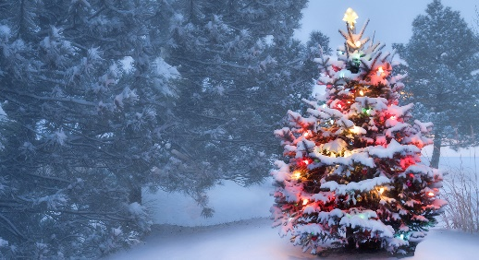
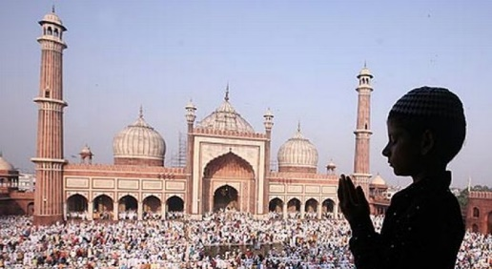
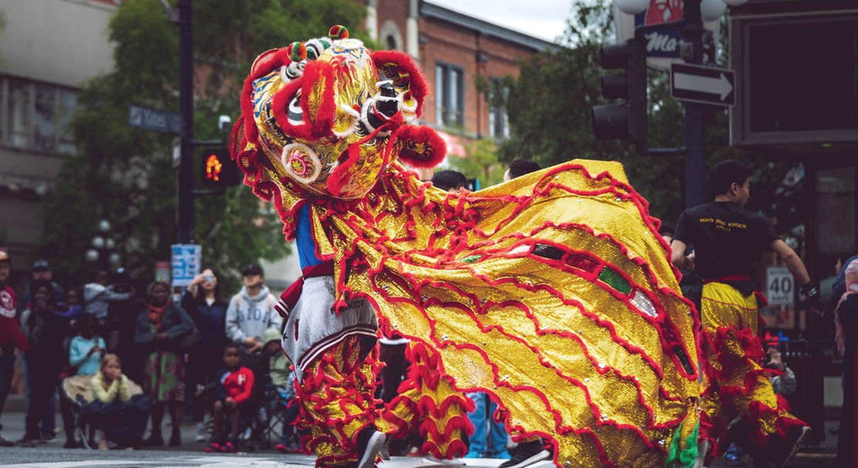
Part II. Celebrations around the World
Instructions: Let’s read about the different celebrations and their meanings.
Christmas is an annual festival that remembers the birth of Jesus Christ.
It is celebrated on December 25 by Christians, but also many non-Christians.
Ramadan is the ninth month of the Islamic calendar. It begins in May and finishes in June. Muslims participate in a month of fasting, prayer and reflection.
Chinese New Year, in the traditional Chinese calendar, begins on the new moon that appears between 21 January and 20 February.
Book II: Linda in Real Life
Centro de Idiomas 2019

Slide 7
Part II. Celebrations around the World
What are the months of these festivities? In what season do they happen?
Month
November
Season
Autumn
Month
December
Season
Winter
Month
December
Season
Winter
Month
April-May
Season
Spring
Month
April
Season
Spring
Month
February
Season
Winter
Book II: Linda in Real Life
Centro de Idiomas 2019

Slide 8
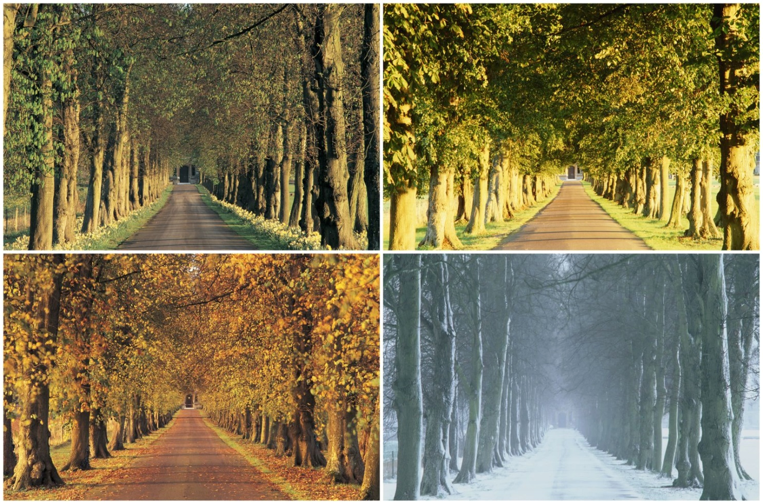
Part III. Describe the Seasons
Describe the weather in the seasons of the year. Include the clothes from the previous chapters:
In spring, the weather is warm but it sometimes rains. People wear jeans and a
t-shirt.
Book II: Linda in Real Life
Centro de Idiomas 2019

Slide 9
Part IV. Select the Correct Word
In some countries the spring is generally warm. In other places on Earth, from January to December it is cold during the 12 months of the year.
There are countries which have very difficult kinds of weather during different times of the year. These are Spring, Summer, Autumn and Winter and they are called Seasons.
In Spring, plants start growing again and trees get new leaves.
After Spring, Summer comes. It's usually much hotter than last, and people can go swimming in the sea or in the lake, they can go hiking in the mountains or relax on the beach during their holidays.
colors | red
white | forests
weather
 | cold
 | ice
 | skating
Book II: Linda in Real Life
Centro de Idiomas 2019

Slide 10
Part IV. Select the Correct Word
Autumn comes after Summer. You can see many colors in the
countryside and the air starts to become colder.
It is sometimes windy, the leaves turn orange, brown and red, and they fall from the trees forests look beautiful and people like going for walks through them.
Then comes the last (or first!) part of the year, Winter. In this time of the year it is usually very cold If it snows, everything turns white You can also see ice on lakes, but there is no color in the fields and countryside now. People can go mountains, sledging and skiing.
trees | seasons
summer | winter
 | forests
weather | December
spring
 | beach
year | skating
Book II: Linda in Real Life
Centro de Idiomas 2019

Slide 11
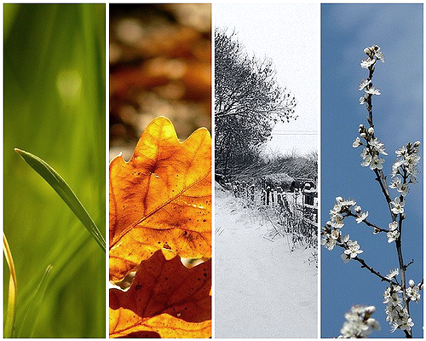
Part IV. Select the Correct Word
You can find the order of the answers here:
weather | December
year | summer
winter | white
trees | seasons
spring | mountains
beach | skating
colors | red
forests | last
cold | ice
Book II: Linda in Real Life
Centro de Idiomas 2019

Slide 12
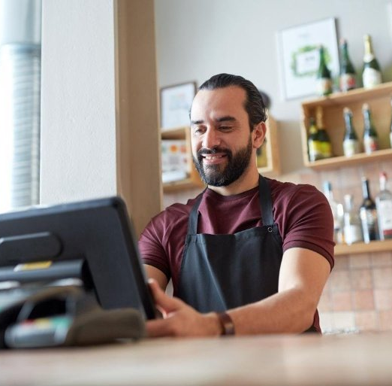
Part V. Present Continuous
The present continuous verb tense indicates that an action or condition is happening now, frequently, and may continue into the future.
Actions at exactly this moment:
You’re reading this sentence.
Actions during this period of time:
This country is changing a lot.
Temporary situations that will or may change:
John’s working in a bar this summer.
Book II: Linda in Real Life
Centro de Idiomas 2019

Slide 13
Part V. Present Continuous
Instructions: Review the affirmative, negative and question forms in the table.
Affirmative | Subject I | Verb To Be am | Verb -ING watching | Information a film.
Negative | Subject I | Verb To Be / Not am not | Verb -ING watching | Information a film.
Question & Answer | Verb To Be or Wh- word What are | Subject you | Verb –ING? watching? | -
 | Yes/ No Are | Subject you | Verb To Be watching | Information a film?
Book II: Linda in Real Life
Centro de Idiomas 2019

Slide 14
Part V. Present Continuous
Instructions: complete the sentences using the present continuous.
They are dancing at the disco. (dance)
She is looking at the map. (look)
They are riding their bikes in the countryside. (ride)
They are visiting an historical city. (visit)
She sun bathing at the beach.(sunbathe)
They are having sushi at a Japanese restaurant. (have)
The father is driving the car. (drive)
They are making a fire to cook their dinner. (make)
Book II: Linda in Real Life
Centro de Idiomas 2019

Slide 15
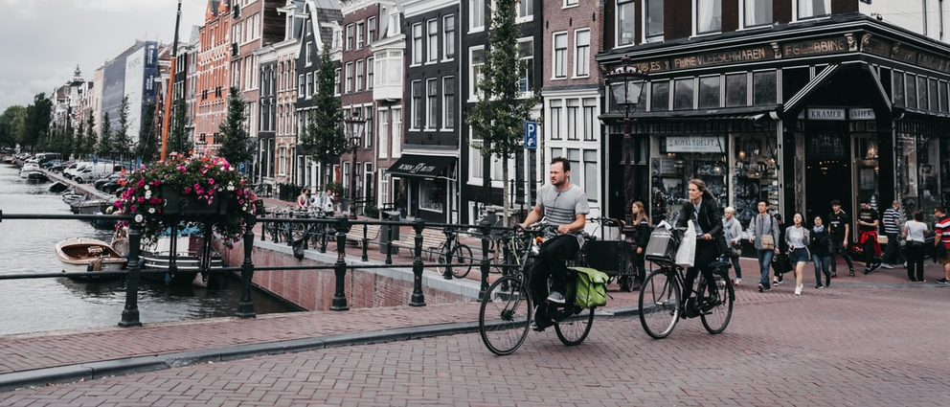
Part VI. What are they doing?
Instructions: Look at the pictures and describe the activity. You have to use the words to make a sentence with the present continuous tense.
Book II: Linda in Real Life
Centro de Idiomas 2019

Slide 16
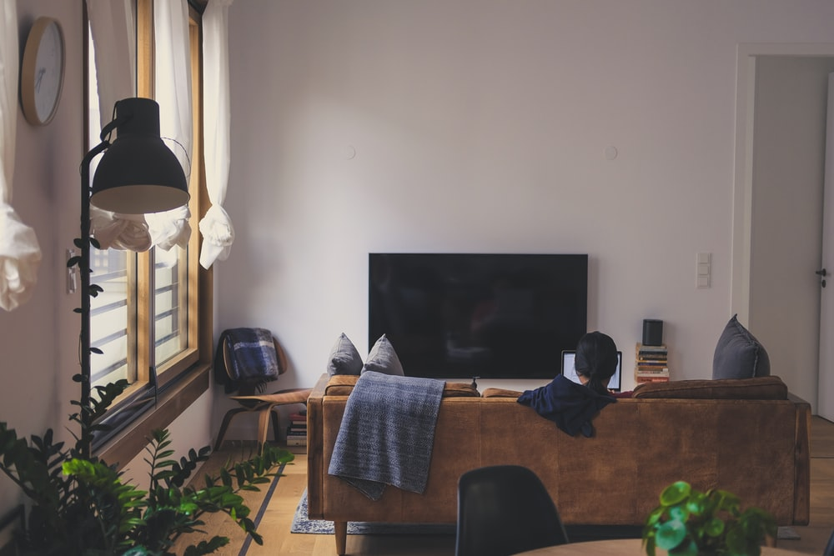
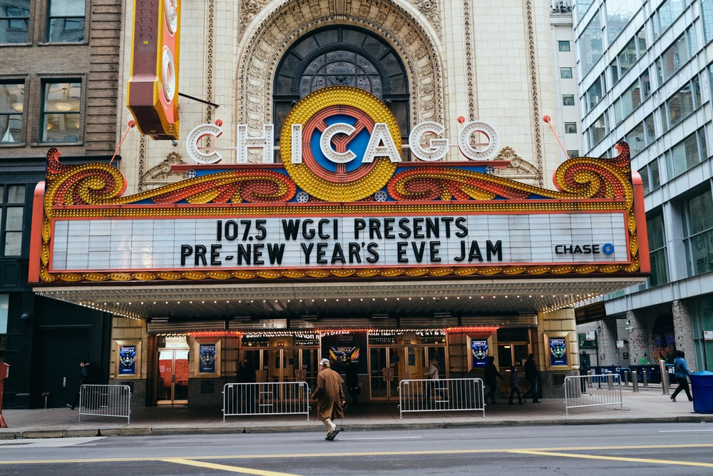
Part VI. What are they doing?
1) He / watch T.V
He is watching T.V.
2. go to the cinema / often:
………………………………………
2) They / go to the cinema :
They going to the cinema
Book II: Linda in Real Life
Centro de Idiomas 2019

Slide 17
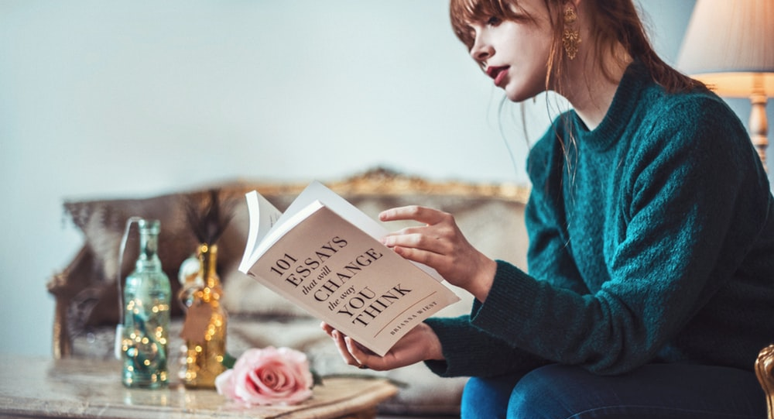
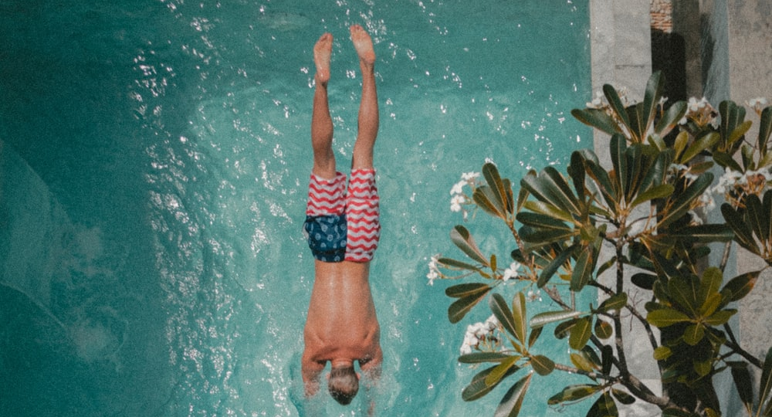
Part VI. What are they doing?
3) She / read a book:
She is reading a book
4) He / go swimming:
He is going to swimming
Book II: Linda in Real Life
Centro de Idiomas 2019

Slide 18
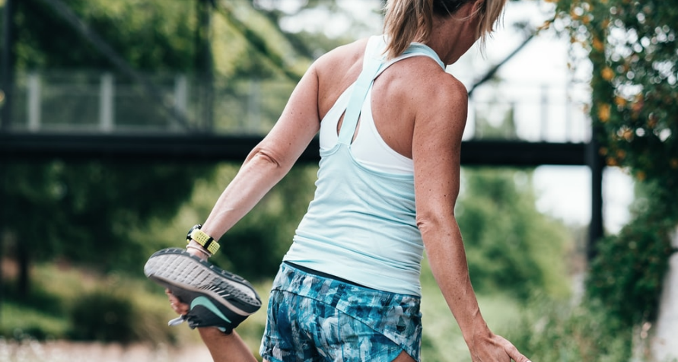
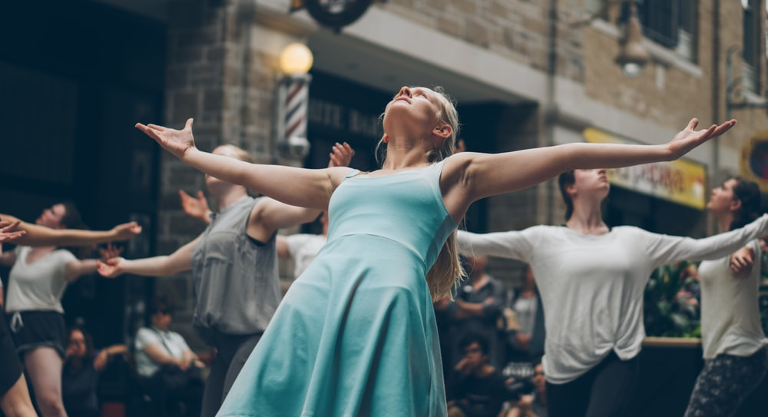
Part VI. What are they doing?
5) We / go running:
We going to running
2. go to the cinema / often:
………………………………………
6) They / dance:
They are dancing
Book II: Linda in Real Life
Centro de Idiomas 2019

Slide 19
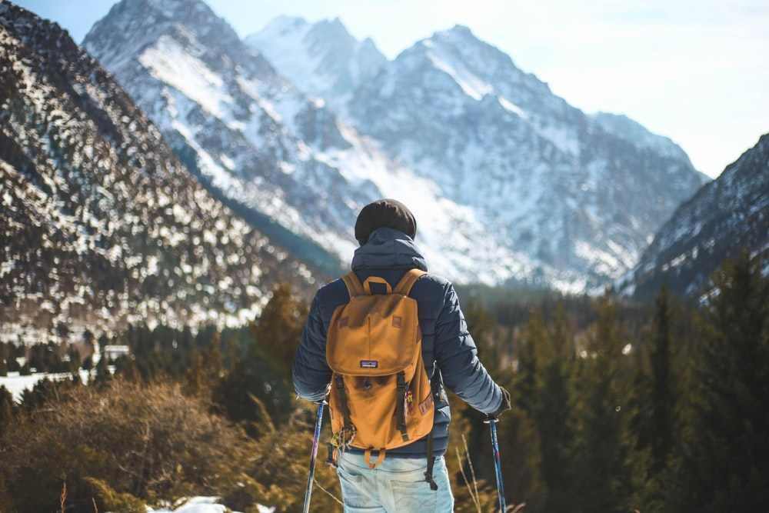
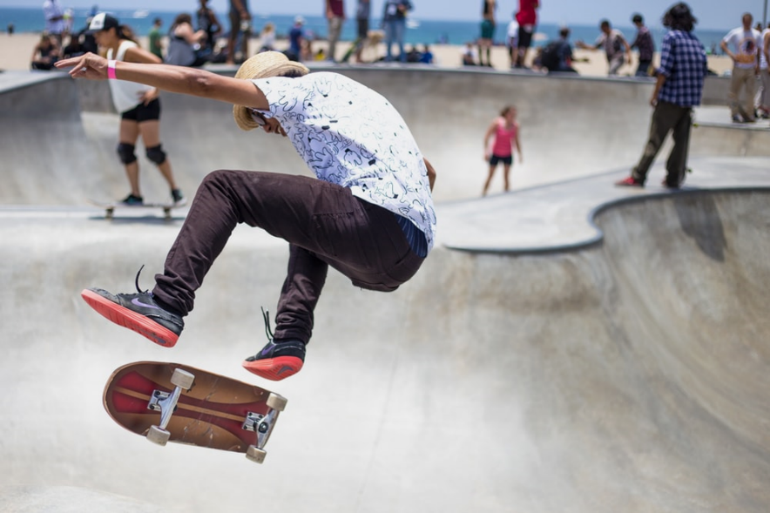
Part VI. What are they doing?
7) I / go hiking
I going to hiking
8) He / skate:
He is skating
Book II: Linda in Real Life
Centro de Idiomas 2019

Slide 20
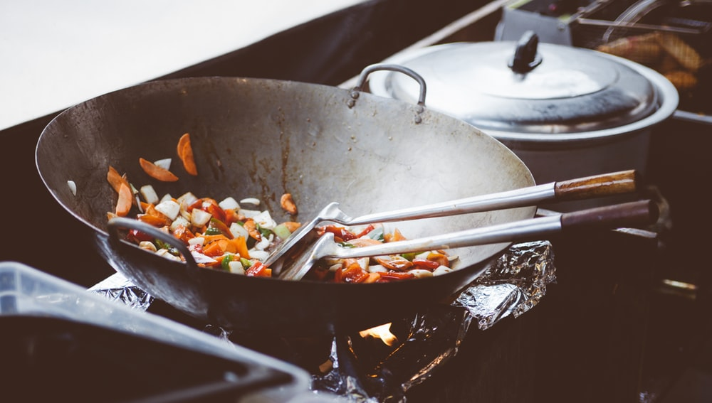
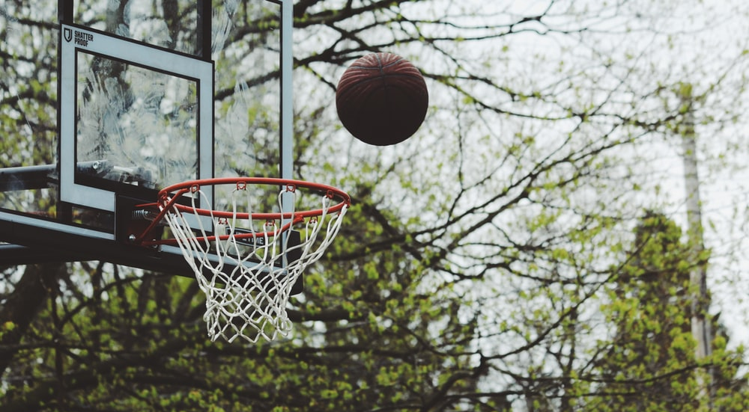
Part VI. What are they doing?
9) We not / cook:
We not going to cook
2. go to the cinema / often:
………………………………………
10) They not / play basketball:
They not going to play basketball
Book II: Linda in Real Life
Centro de Idiomas 2019

Slide 21
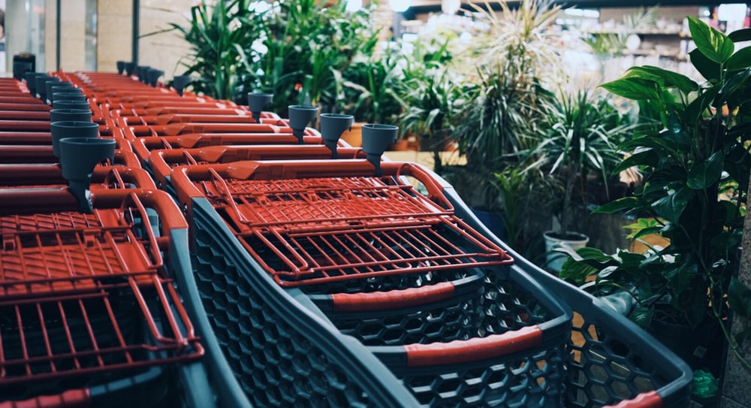
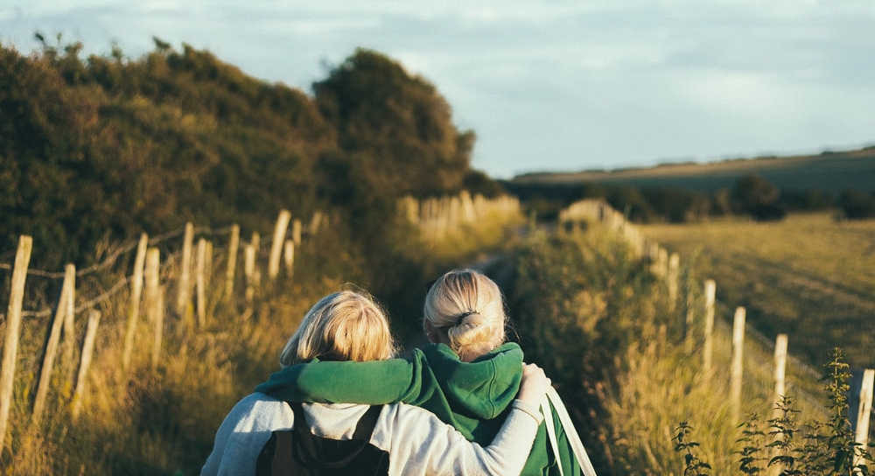
Part VI. What are they doing?
11) He not / go shopping:
He not going to shopping
12) They not / walk in the city:
They not are walking in the city
Book II: Linda in Real Life
Centro de Idiomas 2019

Slide 22
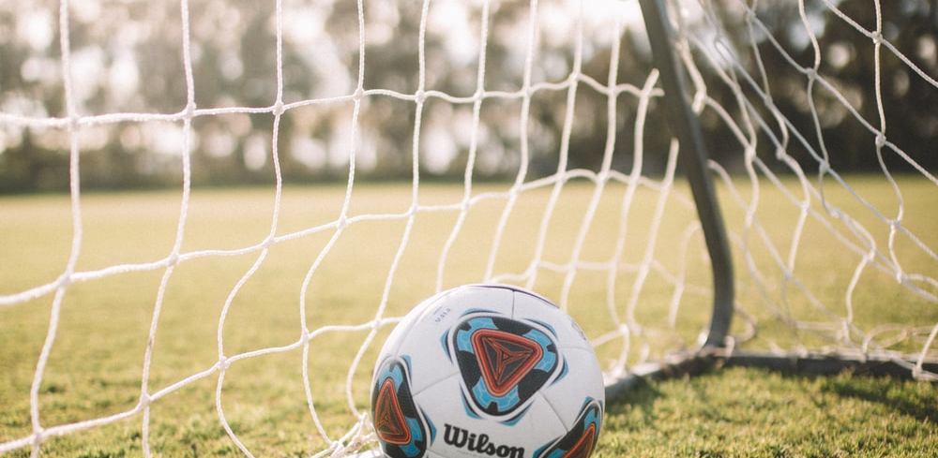
Part VII. Sports and Activities
Instructions: Let’s look at some different sports you might already know.
We’ll also review and describe when and where people practice them.
Book II: Linda in Real Life
Centro de Idiomas 2019

Slide 23
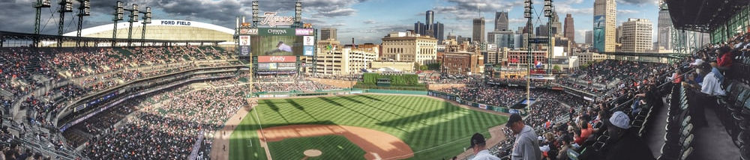
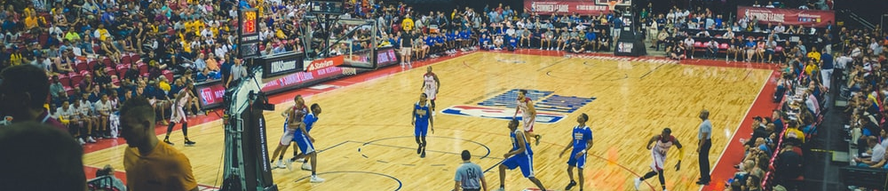
Part VII. Sports and Activities
Outdoor sports: football, baseball, athletics, cycling, golf, water sports
Indoor sports: basketball, gymnastics, volleyball, hockey, boxing, bowling
Book II: Linda in Real Life
Centro de Idiomas 2019

Slide 24
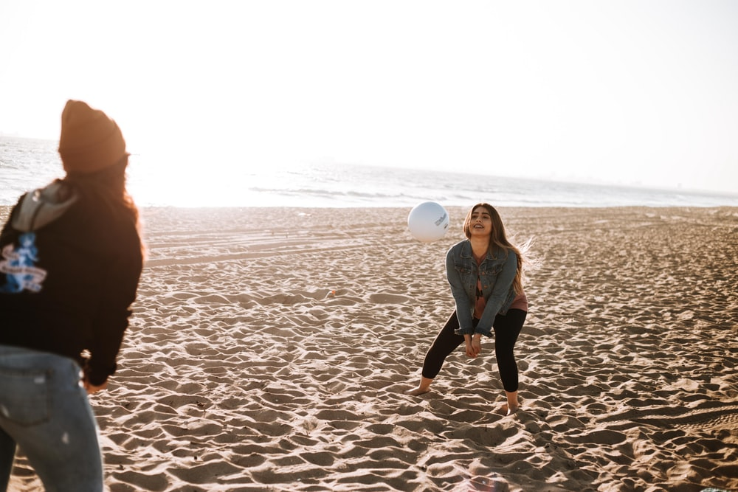
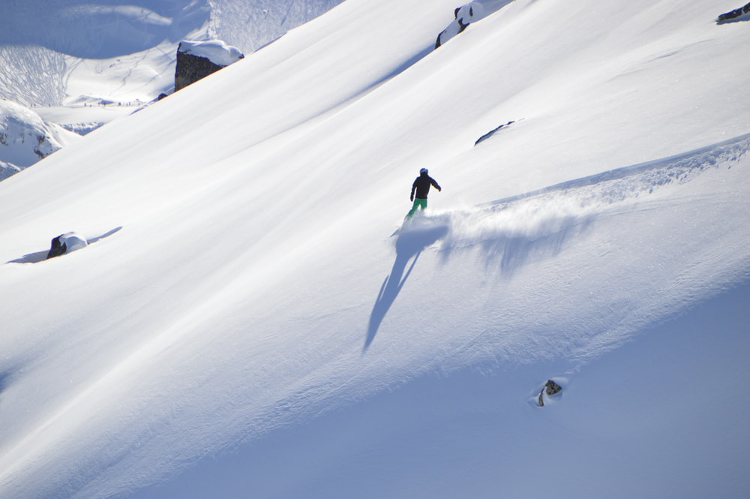
Part VII. Sports and Activities
Summer sports: swimming, surfing, cycling, beach volleyball, running
Winter sports: snowboarding, ice-hockey, skiing, figure skating, bobsleigh
Book II: Linda in Real Life
Centro de Idiomas 2019

Slide 25
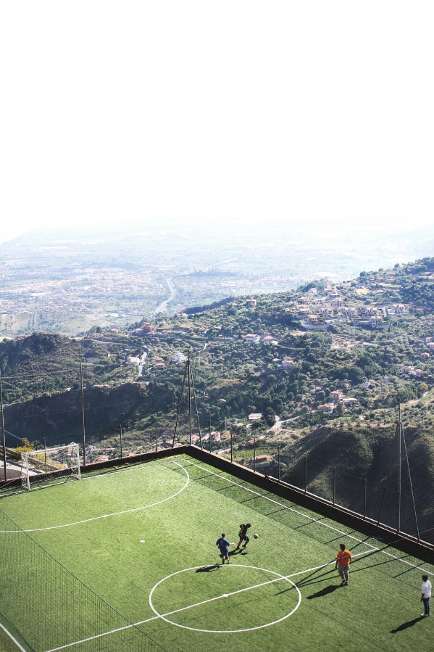
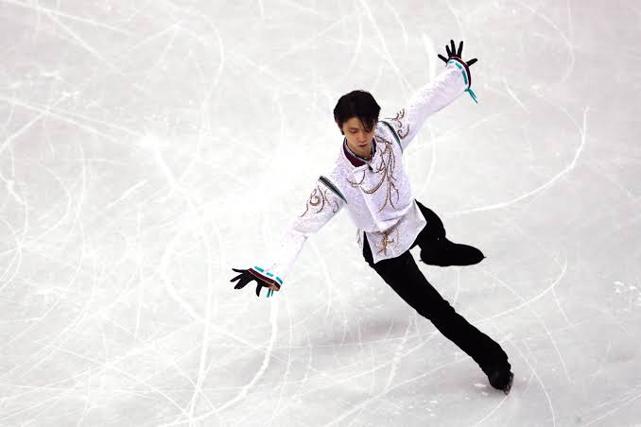
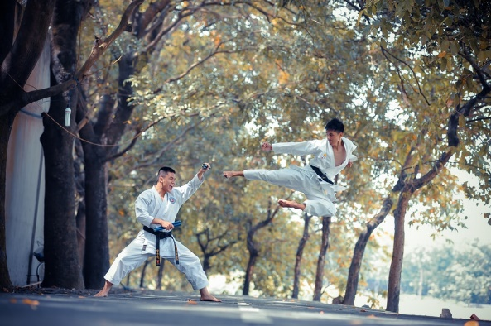
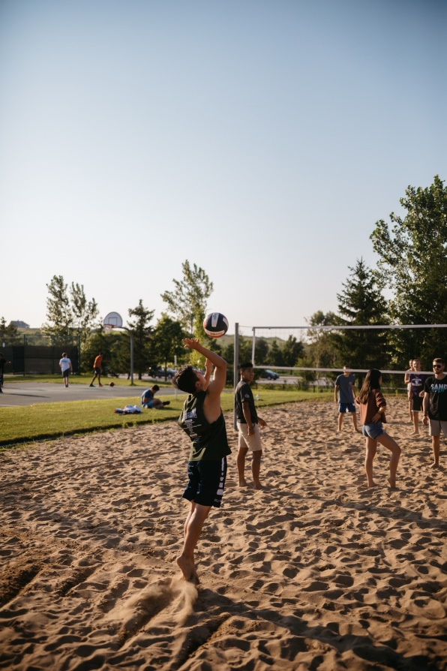
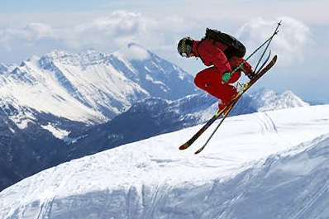
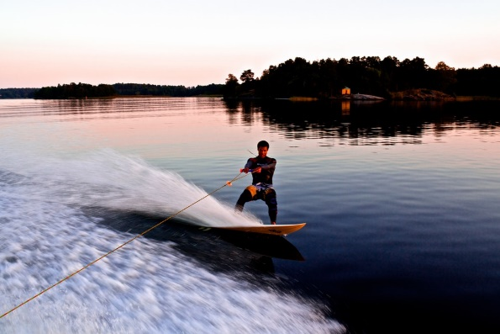
Part VII. Sports and Activities
Instructions: Name the sports and say when and where you practice them.
Ice skating is a winter sport. It is an indoor or outdoor sport...
Book II: Linda in Real Life
Centro de Idiomas 2019

Slide 26
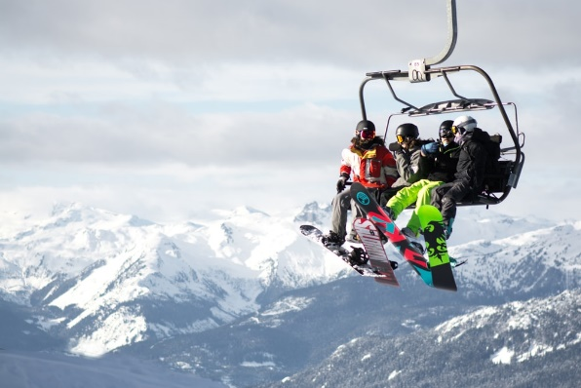
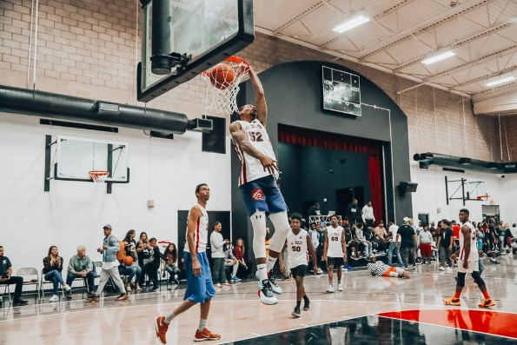
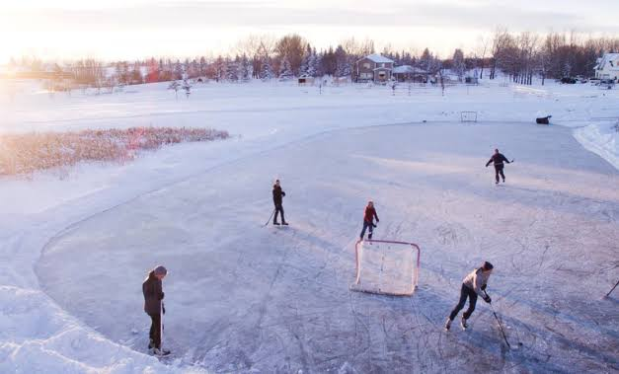
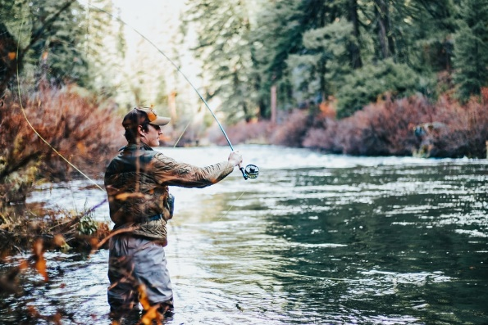
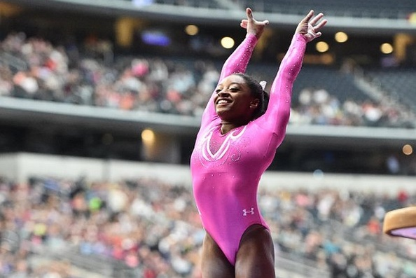
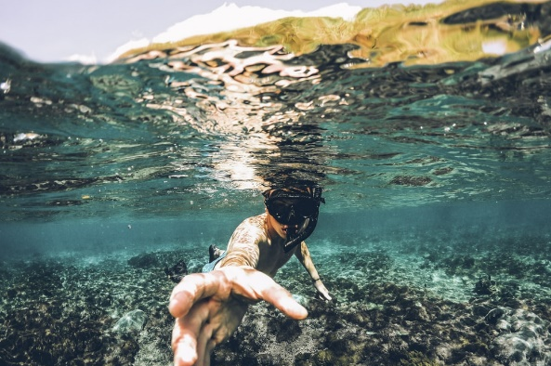
Part VII. Sports and Activities
Instructions: Name the sports and say when and where you practice them.
Ice skating is a winter sport. It is an indoor or outdoor sport...
Book II: Linda in Real Life
Centro de Idiomas 2019

Slide 27
Part VII. Sports and Activities
1.- Skiing is a winter sport and it is an outdoor sport.
2.- Beach Volleyball is a summer sport and it is an outdoor sport.
3.- Artistic gymnastic is an all-season sport and it is an indoor sport.
4.- Soccer maybe, is all-season sport and it is an outdoor sport.
5.- Basketball is all-season sport and it is an indoor sport.
6.- Swimming is a summer sport and it is an outdoor sport.
Book II: Linda in Real Life
Centro de Idiomas 2019

Slide 28
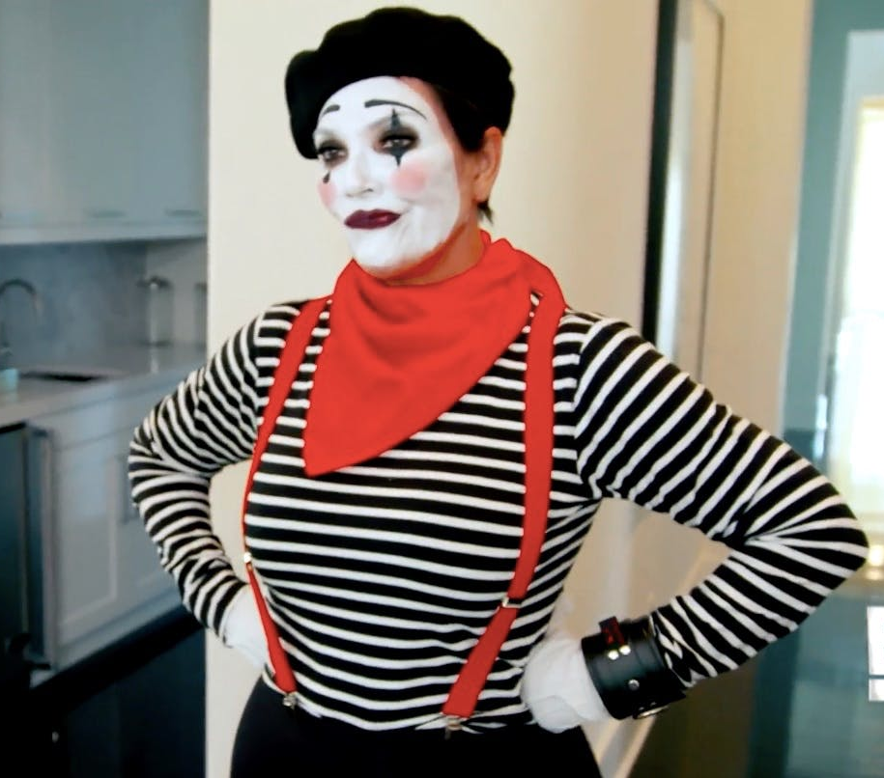
Part VIII. Mime Time
Select a sentences and mime the action. The students will guess the action.
1. You are playing volleyball.
2. You are drawing a picture.
3. You are swimming.
4. You are practicing karate.
5. You are playing computer game.
6. You are playing piano.
7. You are reading a book.
8. You are climbing on mountain.
9. You are fishing.
10. You are crying.
Book II: Linda in Real Life
Centro de Idiomas 2019

Slide 29
Part VIII. Mime Time
Select a sentences and mime the action. The students will guess the action.
11. You are dancing.
12. You are running.
13. You are taking photos .
14. You are doing your homework .
15. You are listening to music .
16. You are skiing.
17. You are playing basketball .
18. You are eating a hamburger.
19. You are driving a car.
20. You are playing baseball.
Book II: Linda in Real Life
Centro de Idiomas 2019

Slide 30
Part IX. My Weekend
Instructions: It’s the weekend and you are speaking to a friend in Canada.
Use the present continuous to describe what you’re doing and your plans.
watch TV | play soccer
go to the cinema | ride
read books | go shopping
swim | travel
sing | drive
run | walk
climb | listen to music
skate | take a shower
cycle | cook
dance | go hiking
Book II: Linda in Real Life
Centro de Idiomas 2019

Slide 31
Part IX. My Weekend
Instructions: It’s the weekend and you are speaking to a friend in Canada.
Use the present continuous to describe what you’re doing and your plans.
-Hi Fer
*Hi John
-What you doing this weekend?
*I’m going to shopping with my wife, later we’re going to the cinema.
-Wow, great plans.
*In the Sunday, we going to walk at park in the morning.
-Beautiful weekend, Fer.
*Have a nice day, John.
-Alike.
Book II: Linda in Real Life
Centro de Idiomas 2019

Slide 32
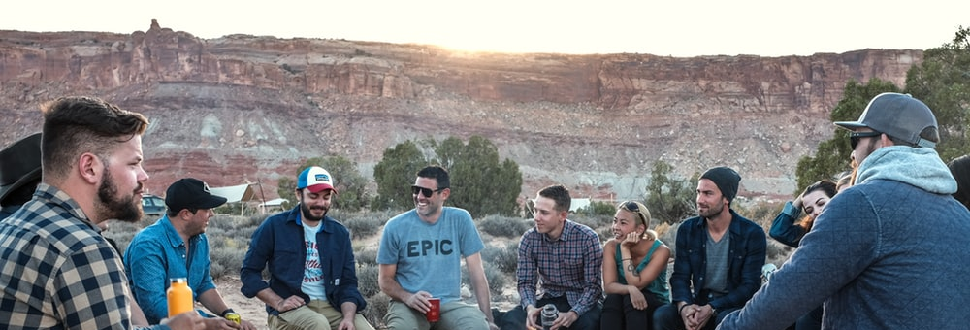
Part X. What have I learnt today?
What have I learnt today?
You can discuss the topic of the weather and describe seasons of year. You’ll also be able to talk about sports and outdoor activities, as well as use the present continuous tense to describe actions at the time of speaking.
Book II: Linda in Real Life
Centro de Idiomas 2019

